Slide 1
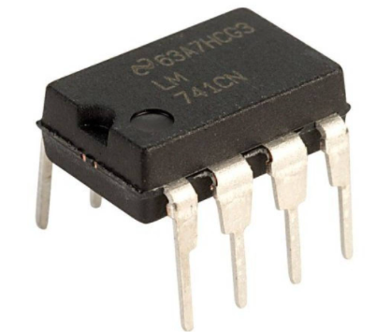
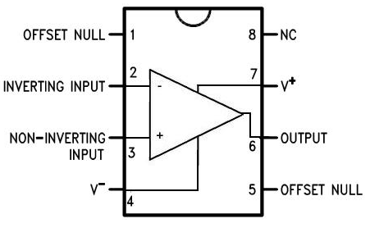
OP-AMP (Operational Amplifier)
Unit-4:

Slide 2
MCQ
In which of the following application op-amp is/are used?
Integrator and Differentiator
Voltage to Current Converter
Adder or Summing Amplifier
All of the above

Slide 3
Introduction
OP-AMP is basically a multistage amplifier which uses a number of amplifier stages interconnected to each other.
OP-AMP amplifies the difference between two signal and diminish common signal.
The integrated op amp offers all the advantage of monolithic integrated circuit such as small size, high reliability, reduced cost, less power consumption.

Slide 4
MCQ
Op-Amp is abbreviated as ________.
Operational Amplifier
Operand amplitude
Operational amplitude
None of the above

Slide 5
MCQ
The Op-amp can amplify
(a) a.c. signals only
(b) d.c. signals only
(c)both a.c. and d.c. signals
(d) neither d.c. nor a.c. signals

Slide 6
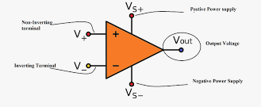
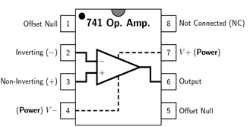
Symbol and terminals
An OP-AMP has a two input terminal, one output terminal and two supply voltage terminals.
The input terminal marked with negative(-) sign is called as an inverting terminal .
If we connect the input signal to this terminal then the amplified output signal is 180º out of phase with respect to input.

Slide 7
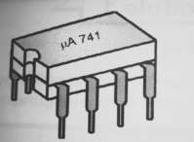
The input terminal marked with positive (+) sign is called as Non-Inverting terminal.
If the input is applied to this pin then the amplified output is in phase with the input.
Offset null is used to nullify the offset voltage and pin no 8 is dummy pin.

Slide 8
MCQ
Op-Amp has _______ gain.
Low
High
Zero
Infinity

Slide 9
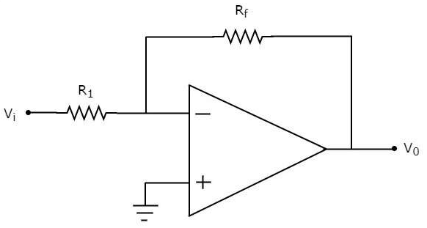
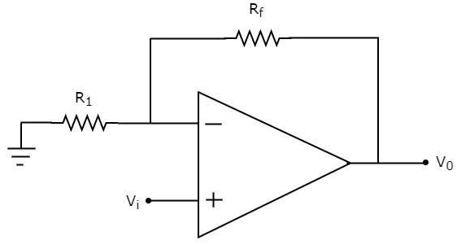


Inverting Amplifier
Non- Inverting Amplifier

Slide 10
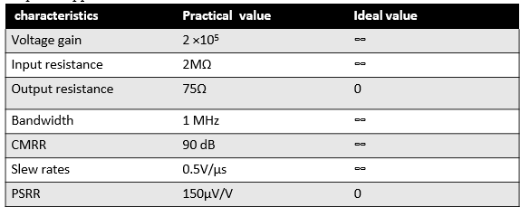
Characteristics of an OP-AMP
Characteristics are important because, we can use them to compare the performance of various op amp ICs and select the best suitable from them for the required application.

Slide 11
MCQ
Which one of the following characteristics is true for ideal op-amp?
Ri=0
Ro= ∞
B.W.= 0
CMRR= ∞

Slide 12
MCQ
Which one of the following characteristics is not true for ideal op-amp?
Ri= ∞
Ro= 0
B.W.= 0
Gain= ∞

Slide 13
MCQ
Which one of the following combination for op-amp characteristics is true ?
Ri= ∞, Voltage gain= 0
Ro= 0, CMRR= ∞
B.W.= 0, Voltage Gain= 0
Gain= ∞, Slew Rate = 0

Slide 14
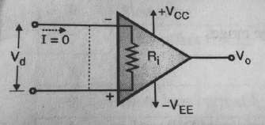
Concept of virtual short
The input impedance of an OP-AMP is ideally
input
infinite. Hence current flowing from one
terminal to the other will be zero.
Thus the voltage drop across Ri will be zero and both the terminals will be at the same potential.
Means they are virtually shorted to each other

Slide 15
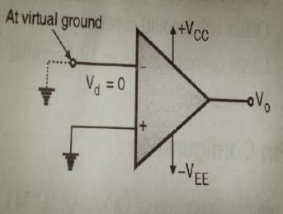
Virtual Ground
If one of the terminal of OP-AMP is connected to ground then due to the virtual short existing between the other input terminal, the other terminal is said to be at ground potential.

